Slide 1
Suicide Rates Overview
Haoyu Wang, Ziyu Wang

Slide 2
Millions of lives have been taken by the virus
Countless families fell into pieces because of the loss of loved ones
Discovered the variables that affect the suicide rates
Researched the reasons behind those phenomena

Slide 3
？
703,000
people commit suicide worldwide each year
based on American Foundation for Suicide Prevention

Slide 4
Goals
1. Discovered the variables that affect the suicide rates
2. Researched the reasons behind those phenomena

Slide 5
Datasets
Suicide Rates Overview 1985 to 2016
Country
Sex
Age
Generation
Suicides number
Population
Suicide number/100k Pop
GDP for the year
GDP per capita
World Happiness Report
2015
Country
Year
Happiness rank
Happiness score

Slide 6
Analysis Aspects & Assumptions
Age & Gender
Happiness Rate
Generation
GDP

Slide 7
Age and gender

Slide 8

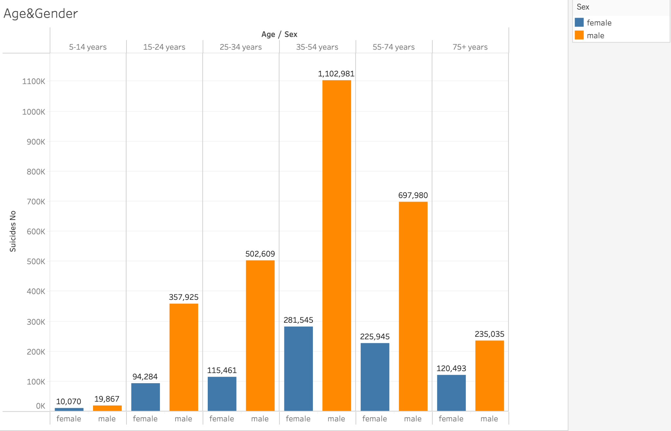
3-4 times easier
to commit suicide for male

Slide 9
Extension Research
Traditional male gender roles discourage emotional expression
More likely for male to get mental illness

Slide 10
Conclusion
Suicide & Mental health issues
(Depression, alcohol use disorder, etc)

Slide 11
2. Country happiness rank

Slide 12
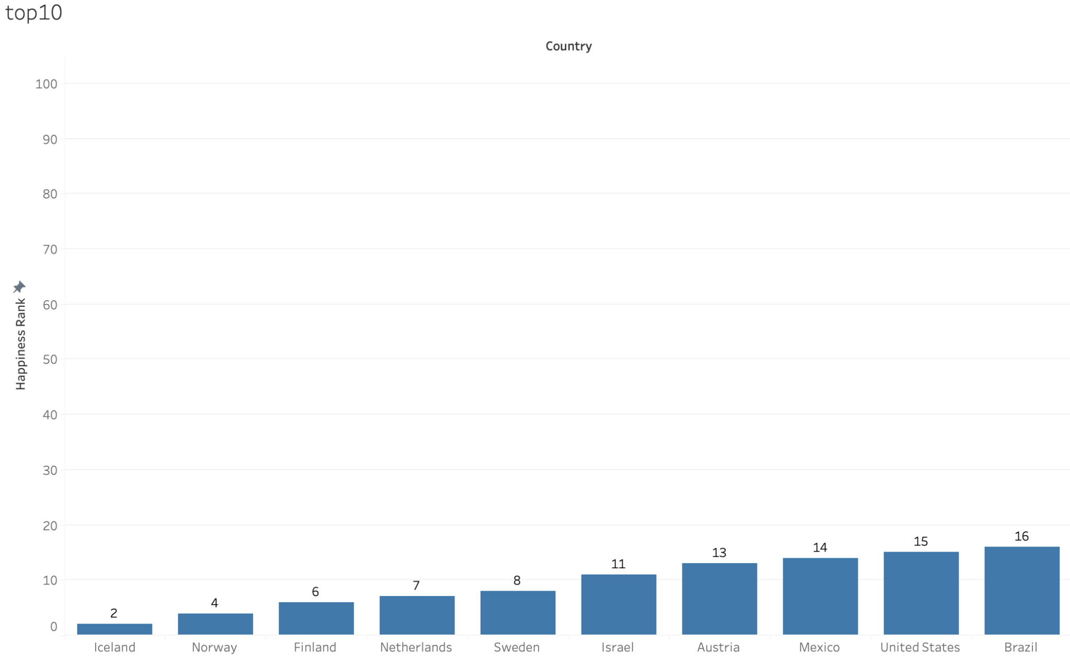
Happiest country

Slide 13
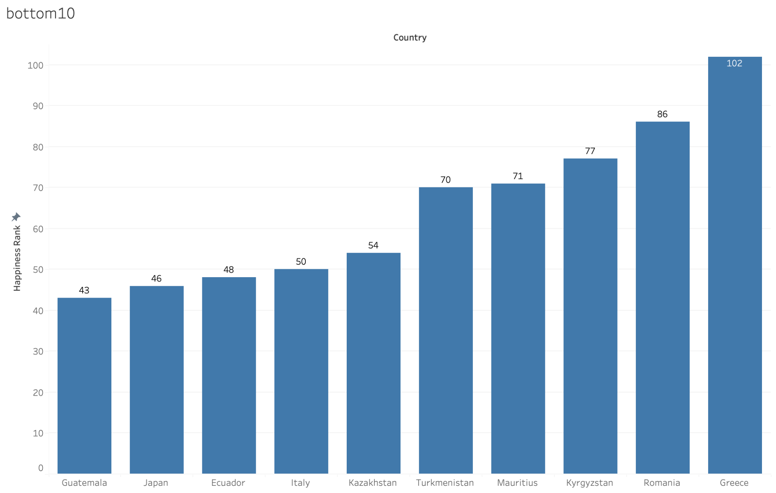
Least happy country

Slide 14
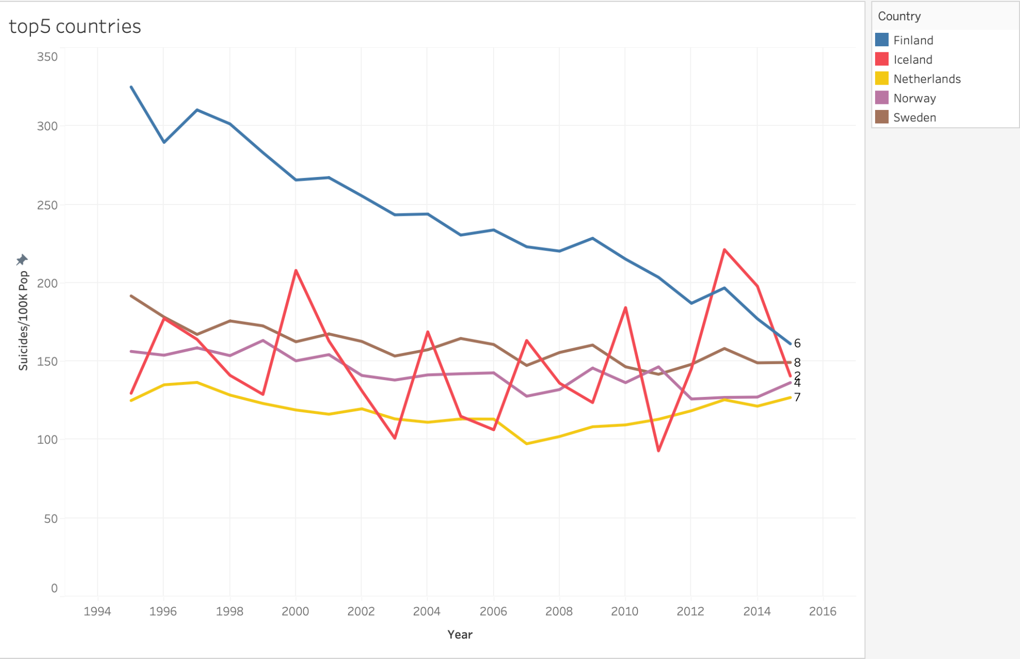

Slide 15
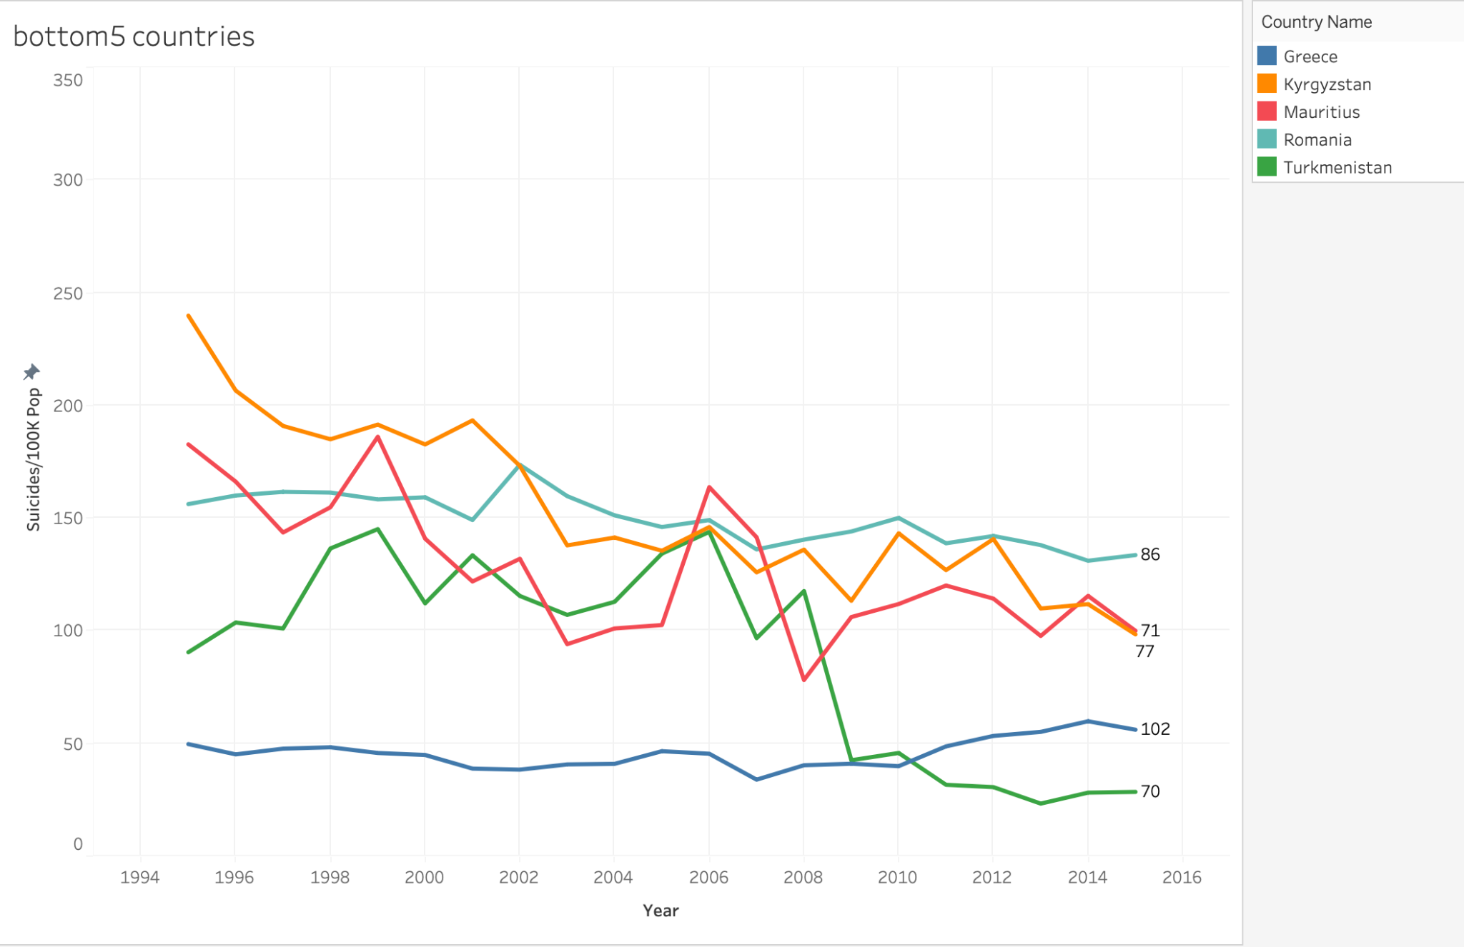

Slide 16
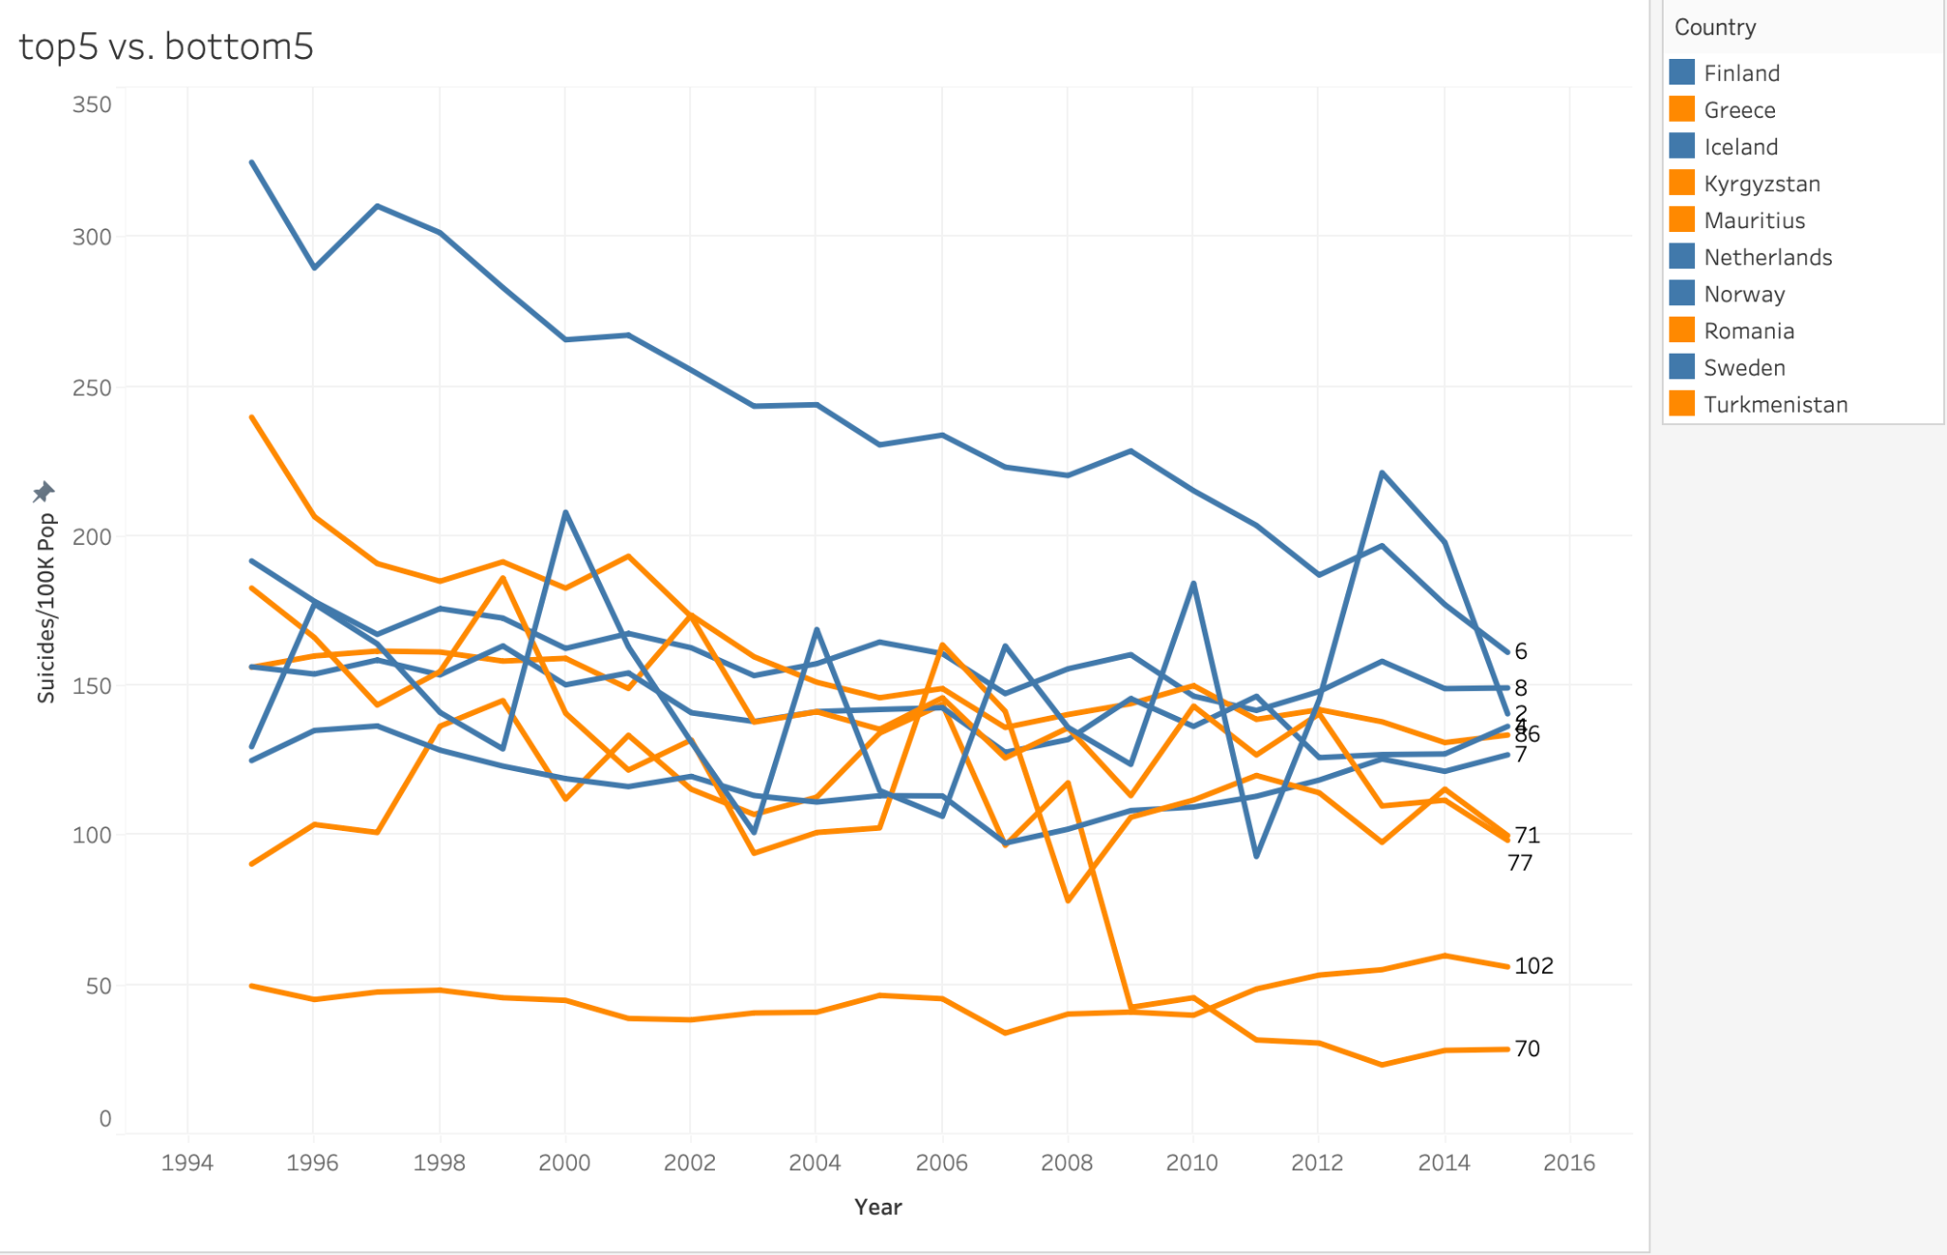

Slide 17
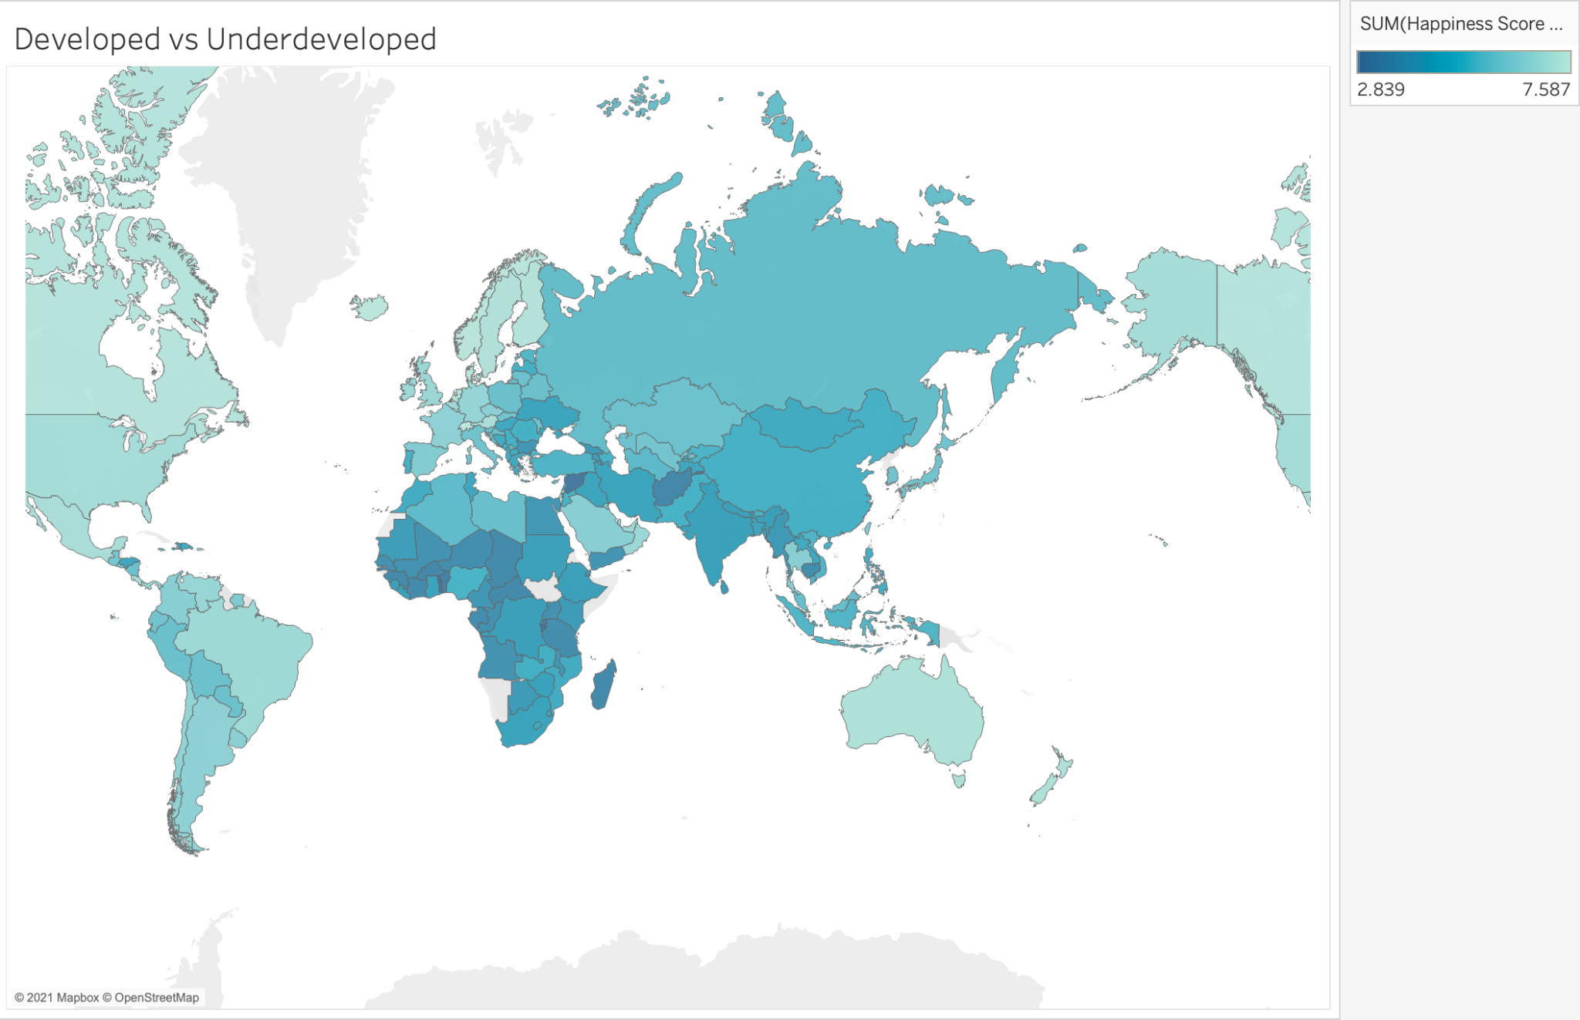
Happiest country

Slide 18
Conclusion
More pressure for making a living
V.s.
Difficult to collect data from underdeveloped countries

Slide 19
3.
Generation
Let dive in a little bit.

Slide 20
A explanation of the concept of generation.
The Greatest Generation — born 1901-1924
Also known as the G.I. Generation
The Silent Generation — born 1925-1945
Baby Boomer Generation — born 1946-1964
Generation X — born 1965-1980
Generation Y — born 1981-1996
This demographic is more commonly referred to as “Millennials” because they became adults at the turn of the millennium.
Generation Z — born 1997-2012

Slide 21
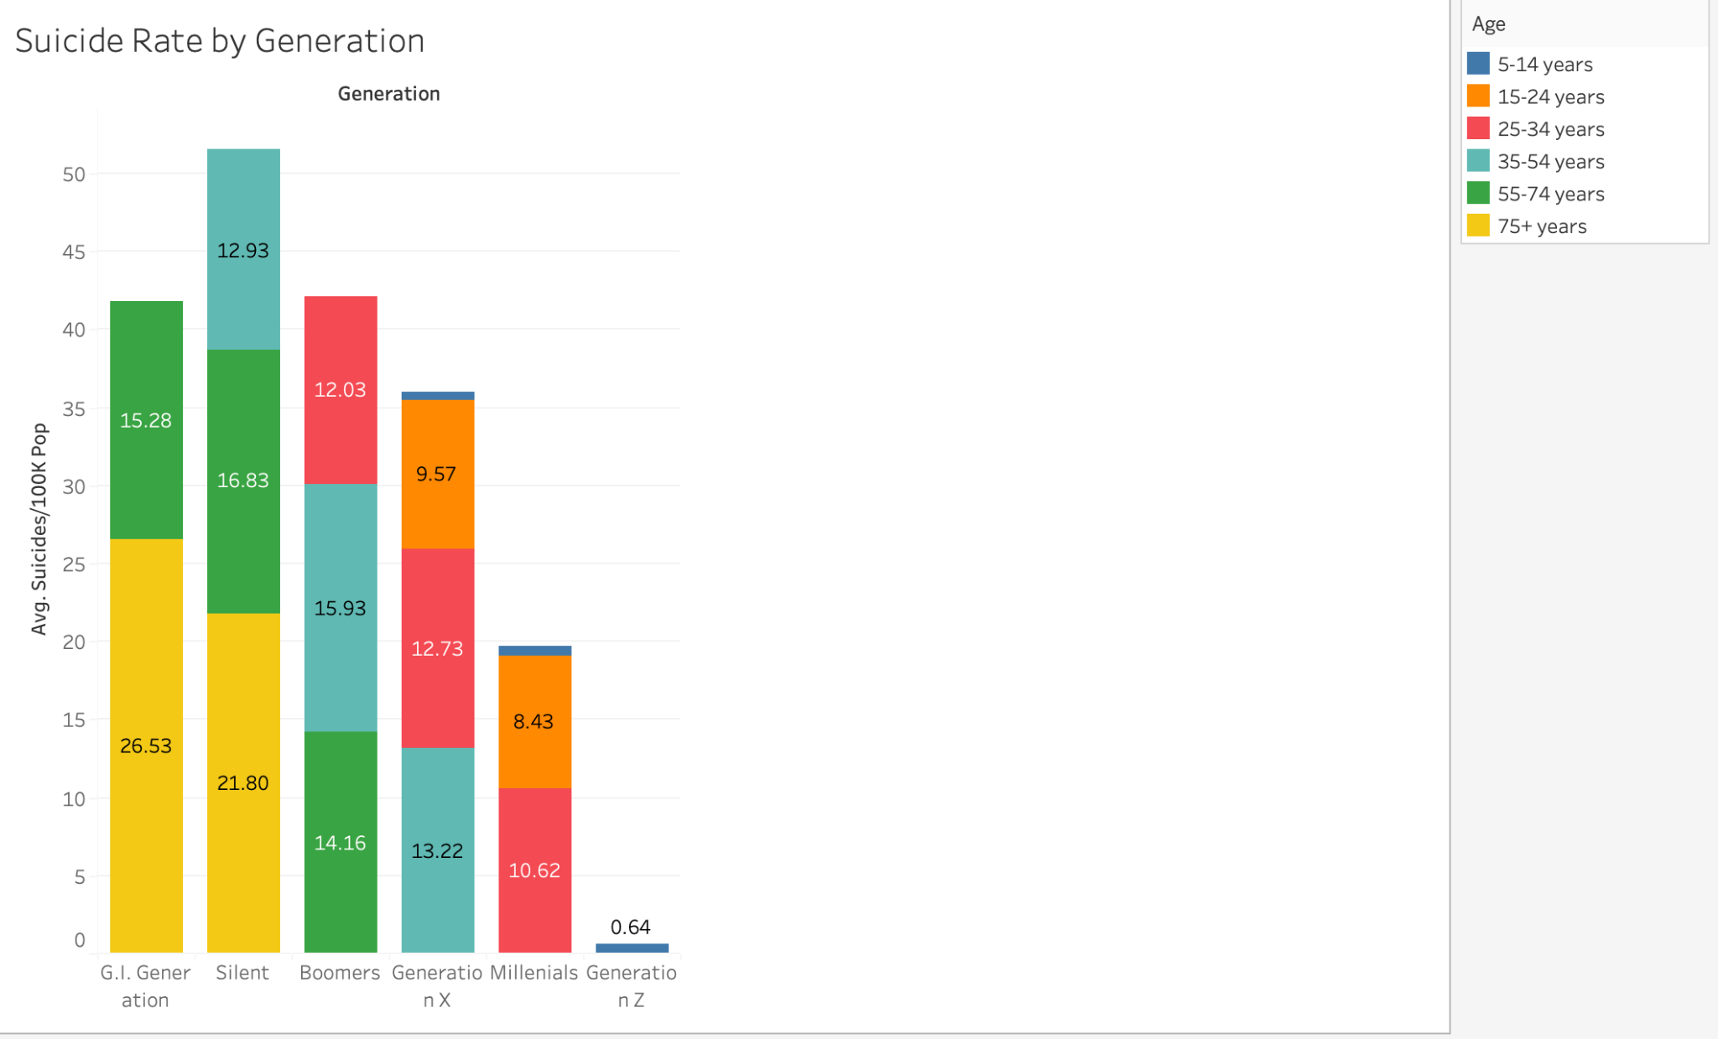
Stacked bar chart of suicide number between different generation

Slide 22
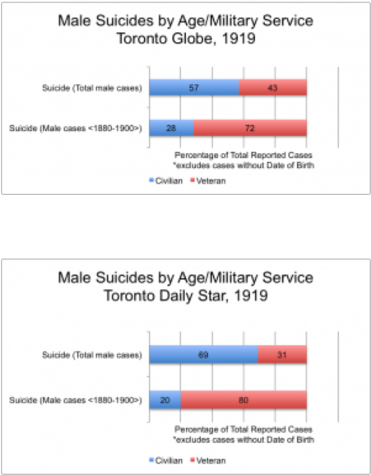
Suicide number of returned soilders and citizens

Slide 23
4.
GDP
Let’s start with the first set of slides

Slide 24
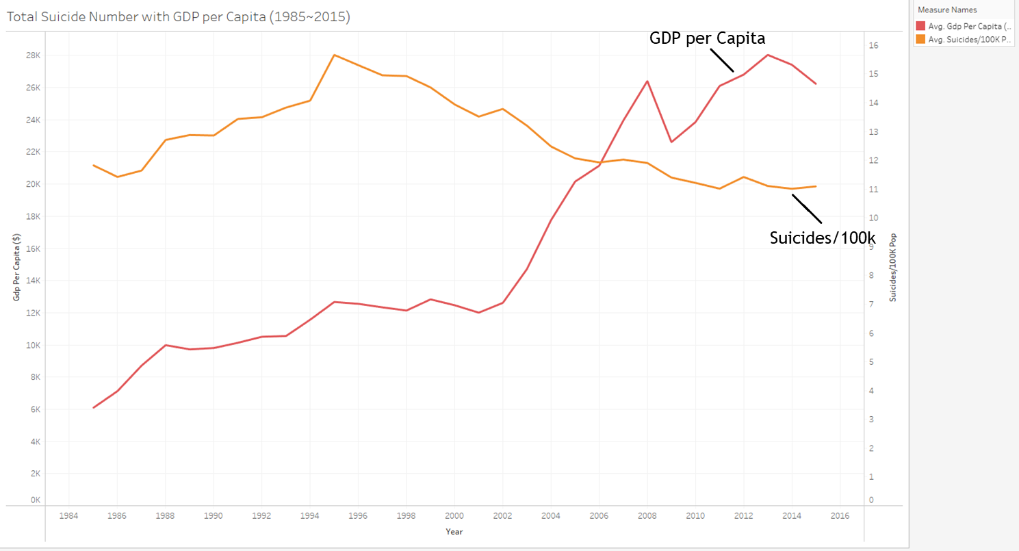
Global GDP per Capita with suicide rate change over time
It is a common assumption that wealth is an essential source of happiness. Thus, we assume a growth trend of economic will result in the decreasing of the suicide rate. And we can see in the visualization that the suicide rate keep dropping since 1995 while the GDP per Capita has maintained a growth trend. Here, we can infer that the increasement of personal wealth have a positive effect on reducing the suicide rate.

Slide 25
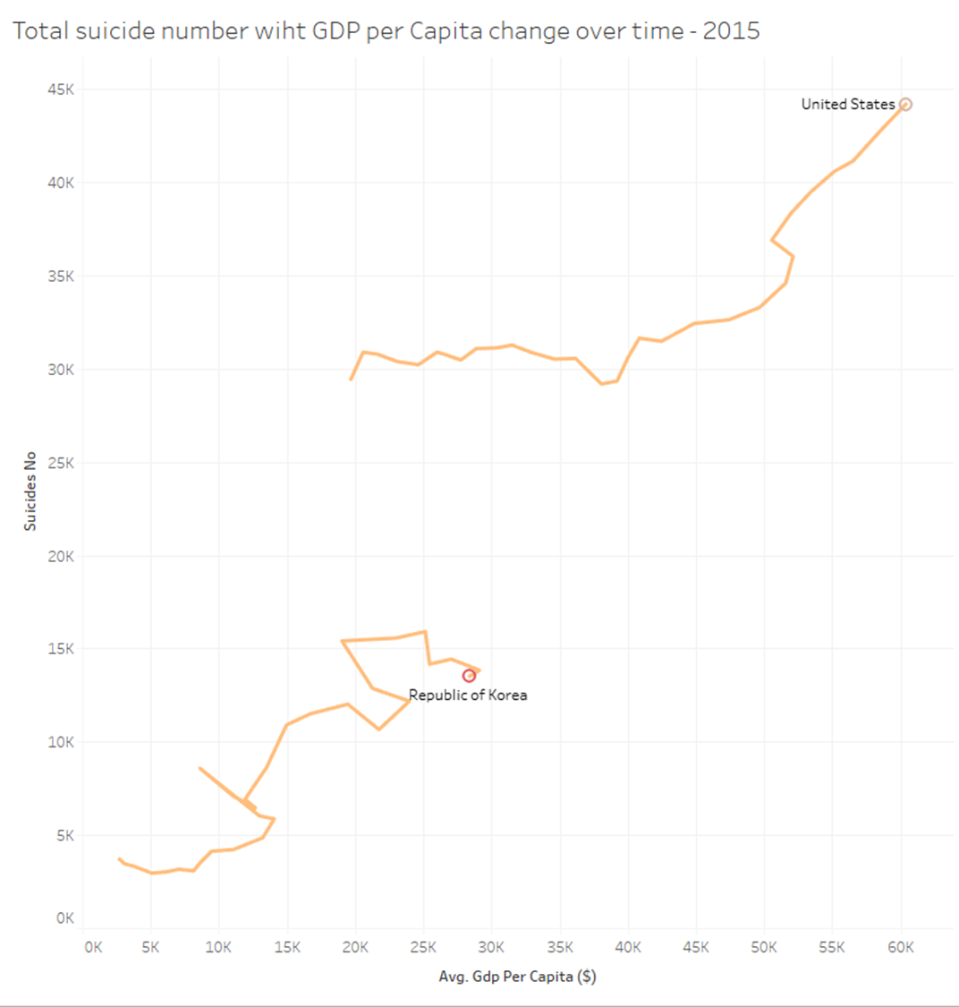
Different pattern of suicide rate with GDP per Capita
We can see the number of suicide number
keep growing even though these countries’
GDP per Capita are growing. We can find a common phenomenon of these two countries
that living expenses and pressure are pretty high

Slide 26
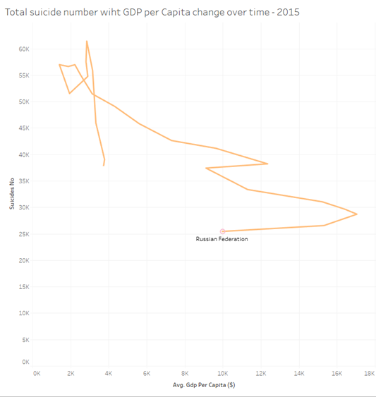
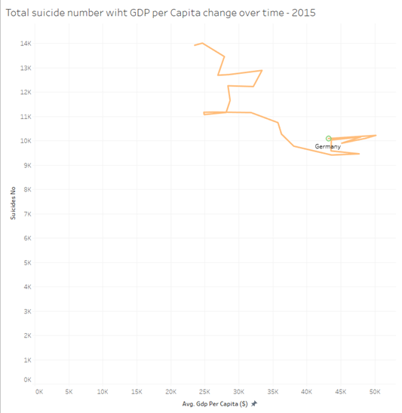
Different pattern of suicide rate with GDP per Capita
But on the other hand, the Russia and Germany’s
total suicide number keep dropping as the growth
of GDP per Capita.

Slide 27
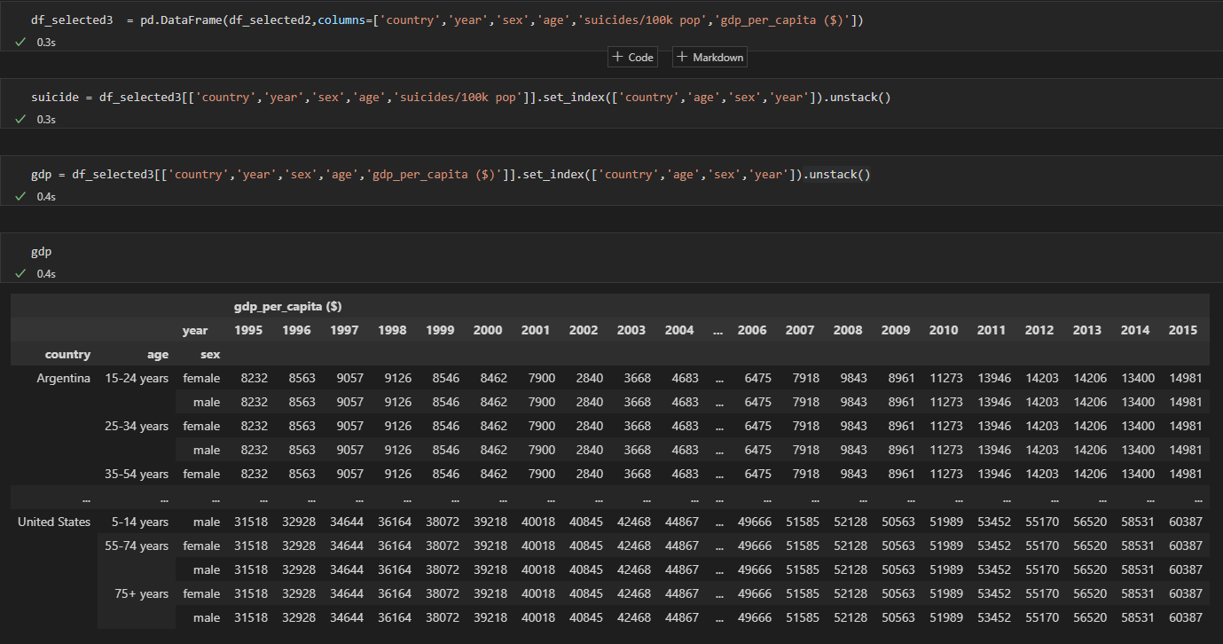
Data Frame Manipulation

Slide 28
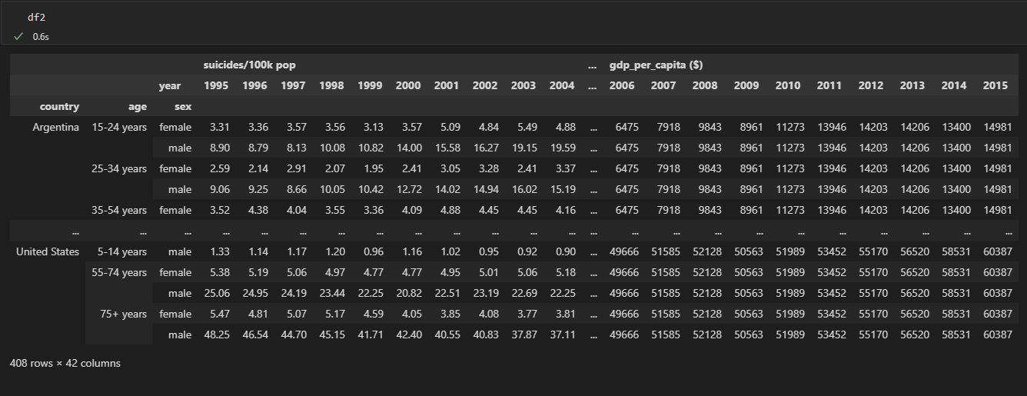
Data Frame Manipulation

Slide 29
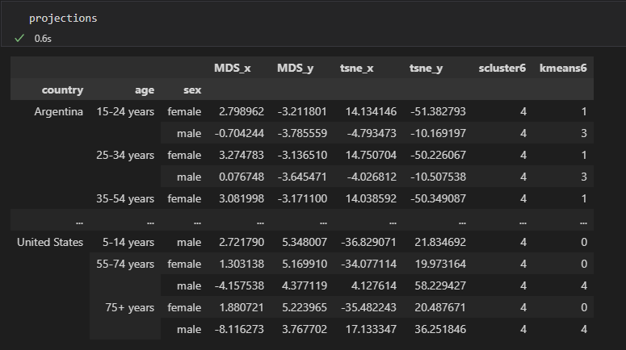
Clustering Result

Slide 30
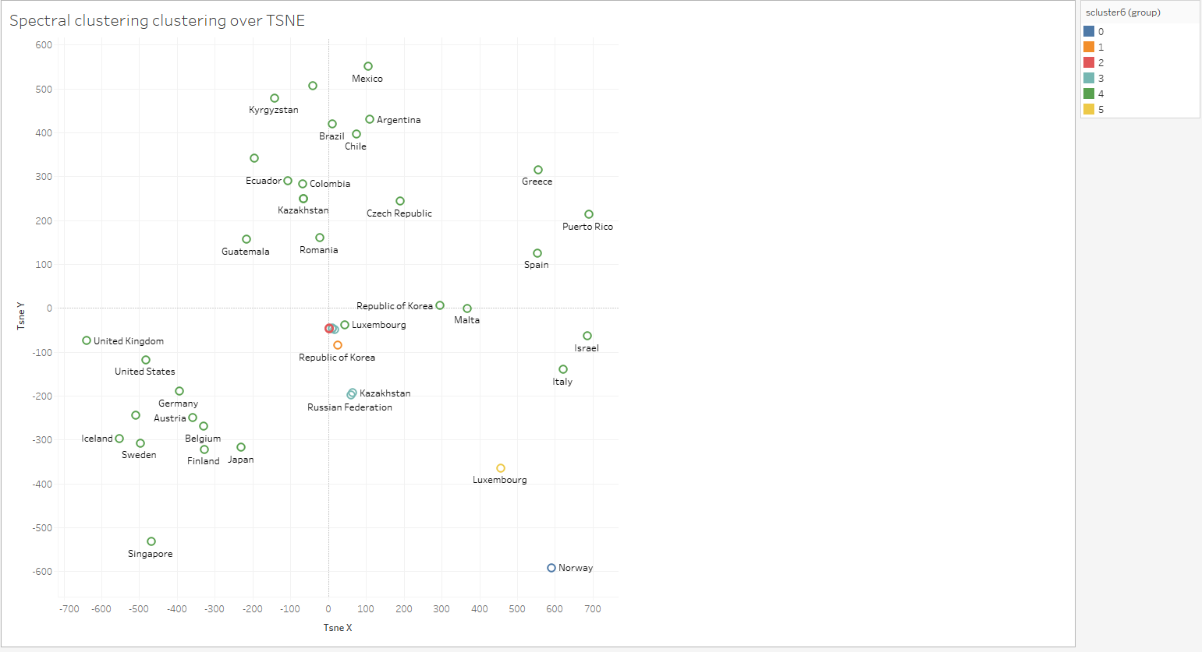
Clustering Visualization

Slide 31
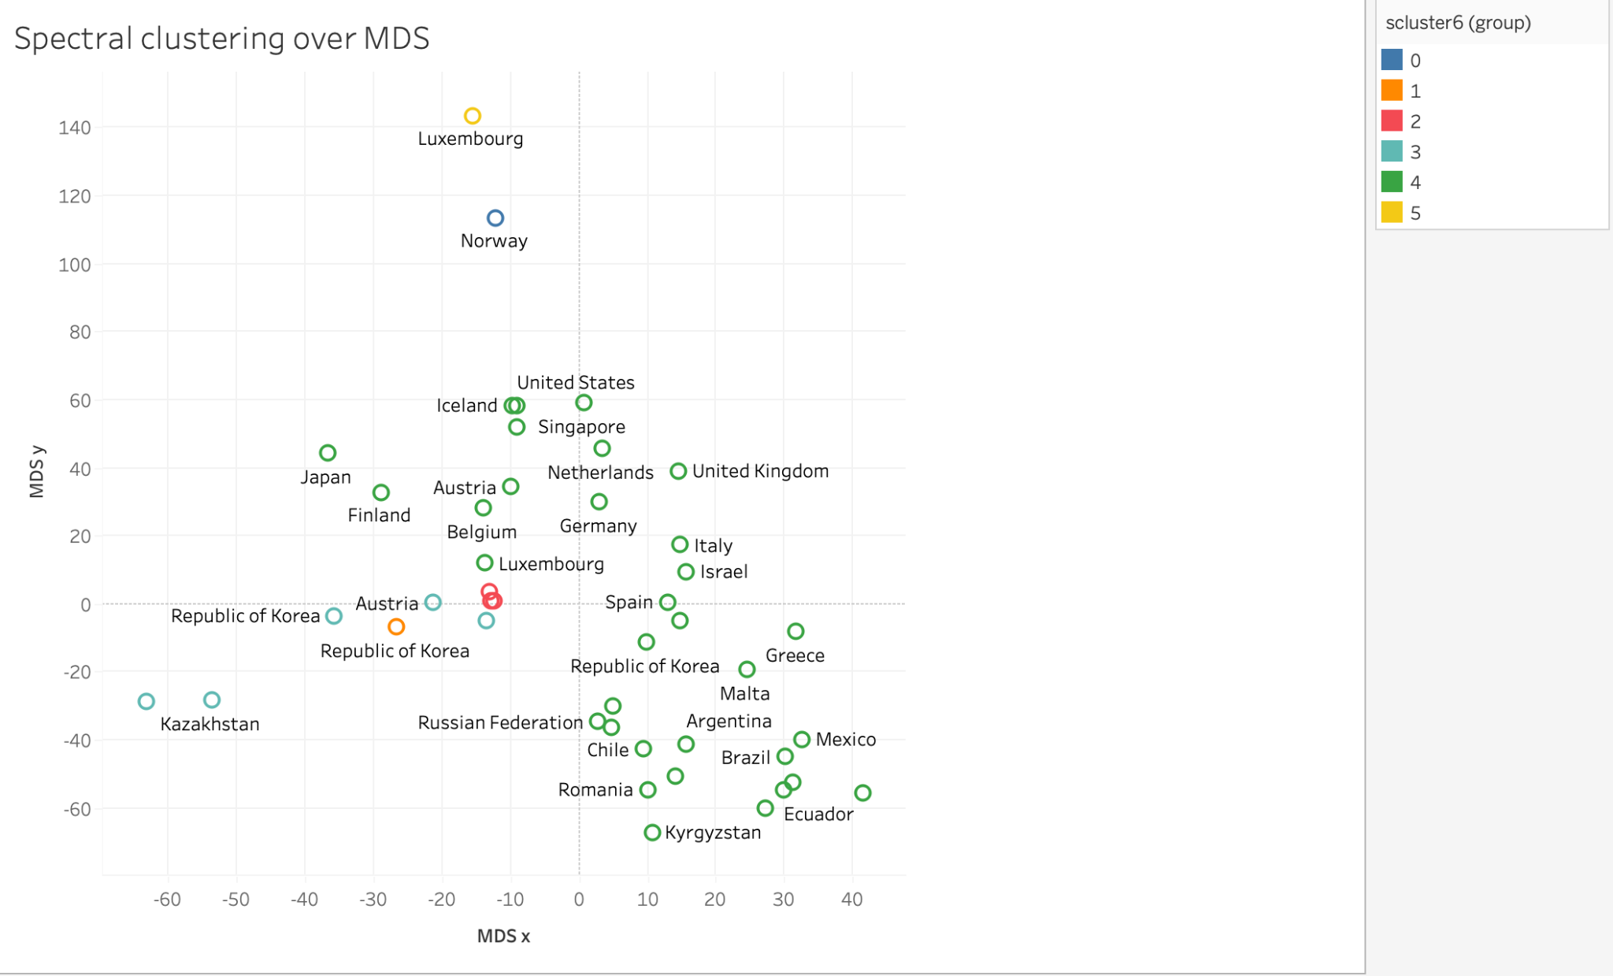
Clustering Visualization

Slide 32
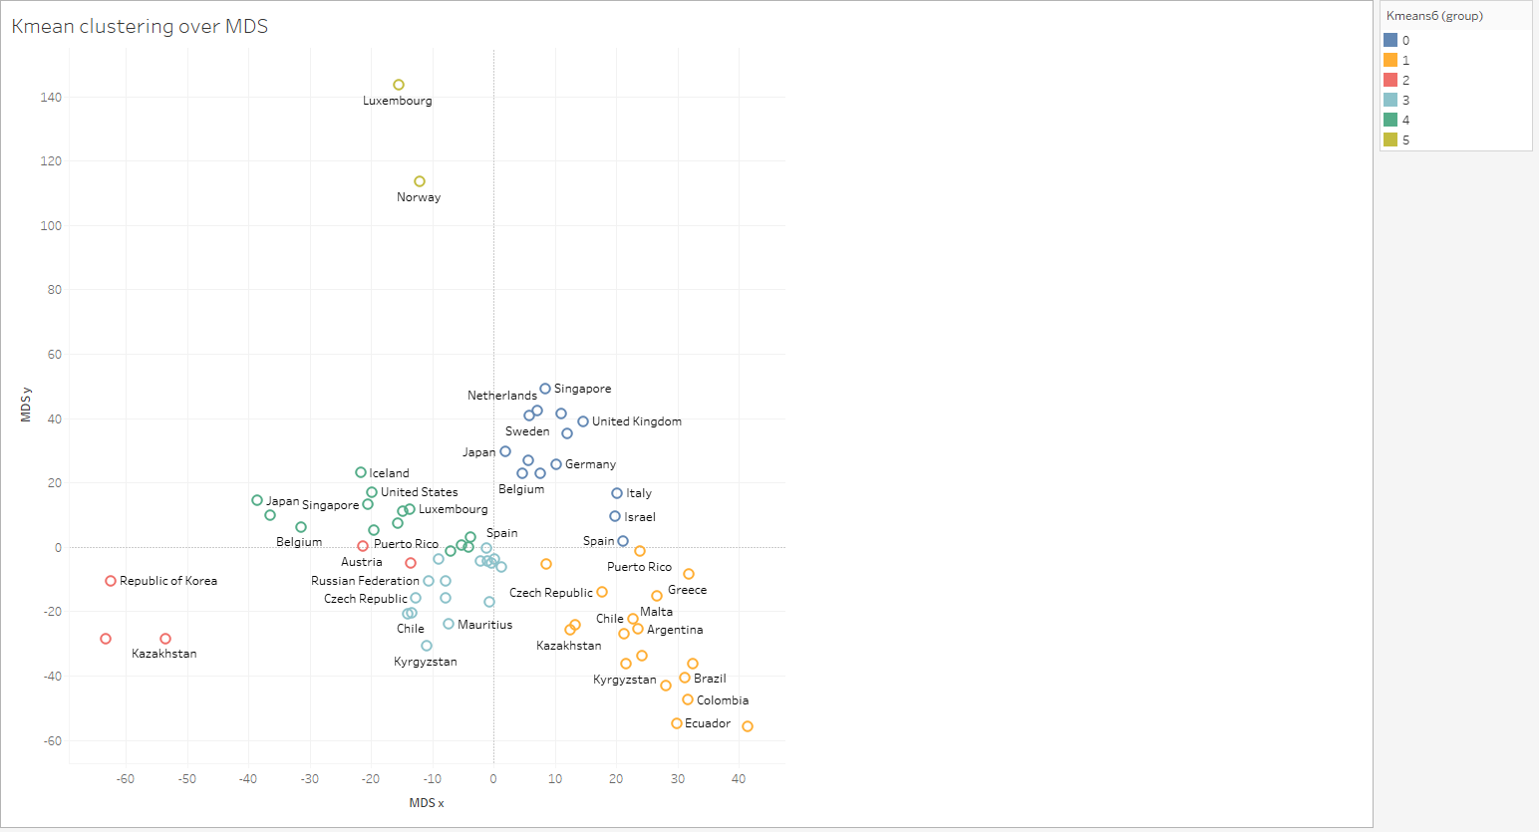
Clustering Visualization

Slide 33
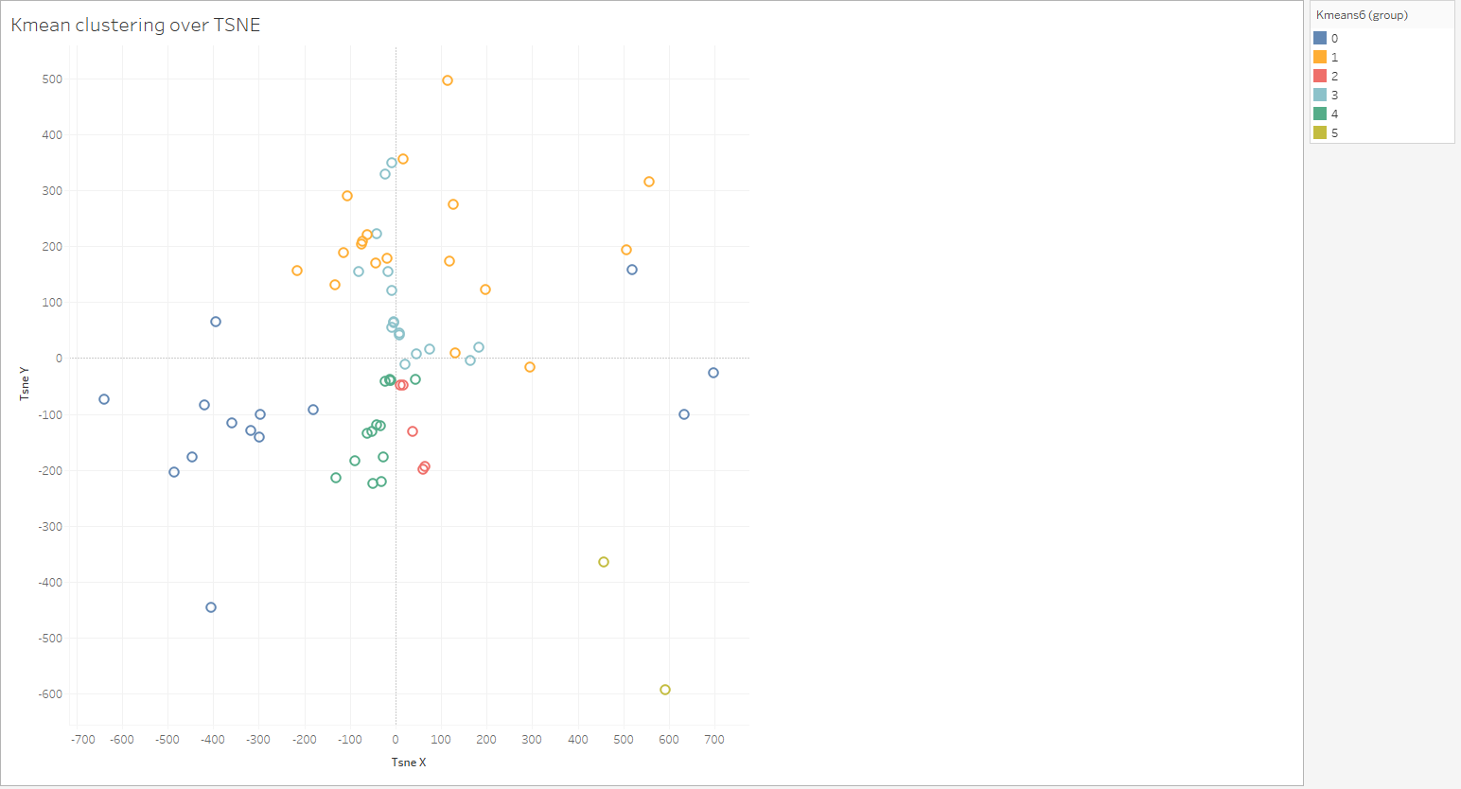
Clustering Visualization

Slide 34
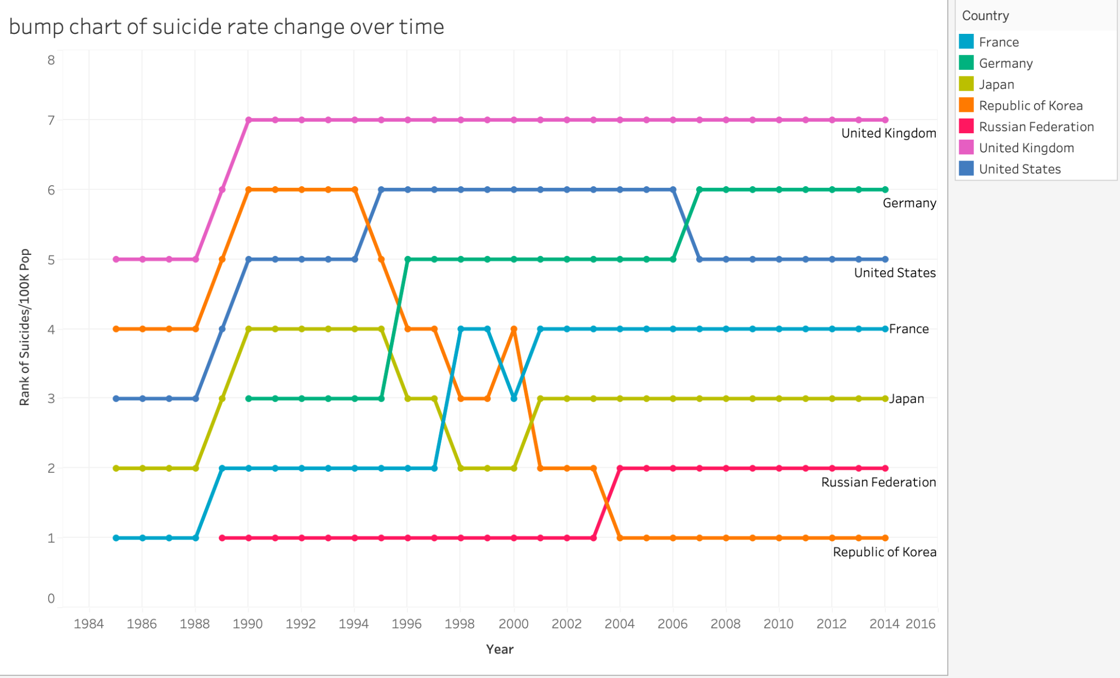
Bump Chart of Suicide Rate Change over Time

Slide 35
Summary
There will be always someone there for you, so
DO NOT GIVE UP!

Slide 36
Any questions?
Thank you!

